Slide 1

WELCOME TO CMS CASH PICKUP TRAINING SESSION

Slide 2
CASH PICKUP : SCR
LARGE CASH PICKUP AREA (2 LACS ABOVE ) SHOULD BE IN CCTV COVERAGE.
CMS OFFICE ISSUES ONE HCIN SLIP PART A TO CUSTODIAN.
RAILWAY OFFICIAL CHECK AUTHORISATION AND I CARD OF CUSTODIAN AND MATCH THE SAME.
SCR SHALL KEEP ENTIRE CASH READY .
SBI DEPOSIT SLIP AND TR CHALLAN/NOTE TO BE FILLED UP.
CMS CUSTODIAN HANDS OVER HIS HCI PART A TO THE SCR STATION AUTHORISED OFFICIAL.
SCR STATION OFFICIAL WILL ALSO TAKE OUT RESPECTIVE HCI PART B FROM HIS HCI BOOKLET ON FIFO BASIS.
SCR OFFICIAL TEARS OFF BOTH PART A AND PART B OF HCI SLIP FOR VERIFICATION.
THE HIDDEN NUMBER AS WELL AS THE HCI SLIP NUMBER OF PART A AND PART B SHOULD MATCH.
AFTER MATCHING THE NUMBERS, SCR OFFICIAL WILL HAND OVER CASH BUNDLES TO CMS CUSTODIAN ALONG WITH DULYFILLED, SEALED & SIGNED HCI SLIP’S PART B, THREE COPIES OF TR CHALLAN AND 1+3 SBI BANK DEPOSIT SLIP.
CUSTODIAN TO COUNT THE CASH AND MATCH WITH NUMBER OF NOTES WRITTEN BY RAILWAY OFFICIAL IN HCI SLIP AND DEPOSIT SLIP AGAINST EACH DENOMINATION.

Slide 3
CASH PICKUP : SCR
IF ANY DISCREPANCY OR SHORTAGE IS FOUND IN THE CASH AT THE TIME OF COUNTING & VERIFICATION, IT WILL BE NOTIFIED TO THE SCR OFFICIAL AT THE PREMISE ITSELF.
THE SCR OFFICIAL NEEDS TO MAKE GOOD OF THE CASH OR ELSE THE DEPOSIT SLIP WILL BE AMENDED TO THE TUNE OF DISCREPANCIES IDENTIFIED AT THE TIME OF VERIFICATION.
AFTER CONFIRMING THE CASH WITH DEPOSIT SLIP AND PART B OF HCI SLIP, CUSTODIAN WILL FILL PART A OF HCI SLIP.
CUSTODIAN WILL STAMP AND SIGN “CUSTOMER COPY” OF PART A AND PART B AND HAND OVER TO SCR OFFICIAL.
SCR OFFICIAL WILL STAMP AND SIGN “AGENTCOPY” OF PART A AND PART B AND HAND OVER TO CUSTODIAN.
CUSTODIAN WILL INSERT ALL THE CASH INTO THE BAG IN FRONT OF SCR OFFICIAL & THE BAG WILL BE SEALED BY CUSTODIAN AND VERIFIED BY SCR OFFICIAL.
SCR WILL WRITE BAG NO AND SEAL NO ON DEPOSIT SLIP AND CUSTODIAN WILL WRITE BAGNO AND SEALNO ON HCI SLIP.
ONE COPY OF THE DEPOSIT SLIP (BANKCOPY) WILL BE KEPT INSIDE THE BAG ALONG WITH THE CASH.

Slide 4
CASH PICKUP : SCR
SEAL BAG PROCESS WILL BE USED AT HIGH VOLUME STATIONS.
AFTER COLLECTING CASH IN SEALED BAG, CUSTODIAN WILL ISSUE THE DULY FILLED “CUSTOMER COPY” OF HCI SLIP & DEPOSIT SLIP (SCR TEMP COPY) AS AN ACKNOWLEDGMENT OF CASH RECEIPT.
CUSTODIAN WILL TAKE THE SEAL & SIGNATURE OF SCR OFFICIAL ON BOTH THE COPIES OF PART A.
CUSTODIAN WILL RETAIN BOTH “AGENT COPY” OF PART A & PART B OF HCI SLIP AND ISSUE THE “CUSTOMER COPY” TO THE SCR OFFICIAL AS AN ACKNOWLEDGMENT OF CASH RECEIPT.
CUSTODIAN SHALL UPDATE THE VISIT REGISTER AND BOTH CUSTODIAN AND SCR OFFICIAL WILL SIGN THE UPDATED ENTRY.
UPDATE THE TRANSACTION DETAILS IN CMS MOBILE APPLICATION FOR REPORTING AND RECON.

Slide 5
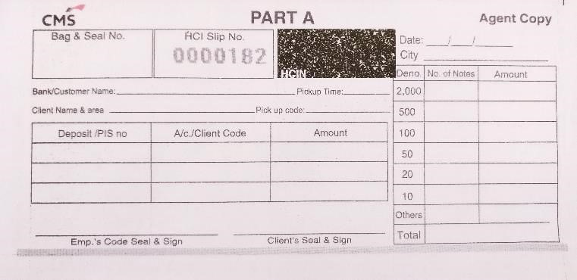

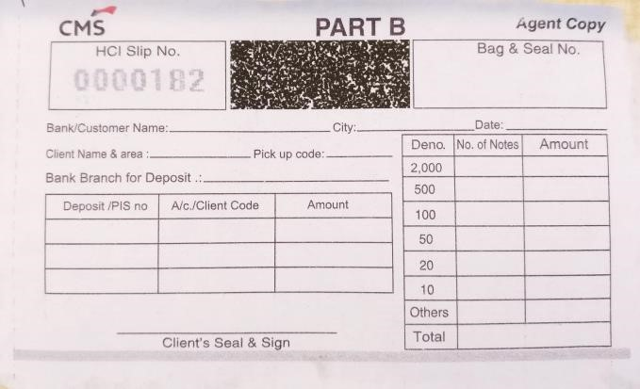
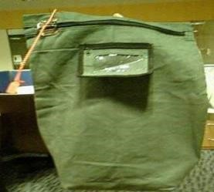
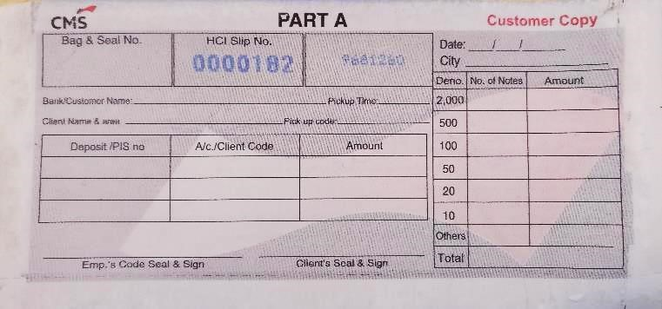
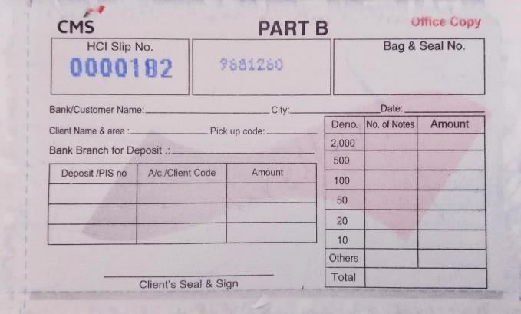
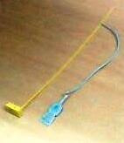
DOOR STEP SERVICES: STATIONARY AND TOOLS
CMS AGENT COPY
CMS
I Card
CUSTOMER COPY
Seal Bag
One Time Seal

Slide 6
GUIDELINES FOR FILLING HCIN SLIPS
HIDDEN NUMBER OF BOTH THE SLIP HAVE TO BE MATCHED TO PROCEED WITH TRANSACTION.
PART A TO BE FILLED BY CMS AGENT.
PART B TO BE FILLED BY RAILWAY OFFICIALS.
ALL THE DETAILS ON HCI SLIP TO BE CLEARLY FILLED.
HCI WILL ONLY BE USED FOR CAPTURING CASH DETAIL, CHEQUE AMOUNT NOT TO BE CAPTURED IN HCI.
ONLY COUNT OF CHEQUE TO BE WRITTEN ON HCI SLIP FOR TRACKING.
BOTH PART A AND PART B TO BE SIGNED AND STAMPED BY CMS AGENT AND RAILWAY OFFICIALS.
FRONT CMS/AGENT COPIES OF PART A AND PART B WILL BE KEPT BY CMS AGENT.
SELF CARBON BOTTOM RAILWAYS COPIES OF PART A AND PART B WILL BE KEPT BY RAILWAY STATION.
ENSURE THAT BOTH THE BOOKLET OF HCI PART A AND PART B ARE NEVER ALLOWED TO KEPT AT RAILWAY
STATION.
IF HCI SLIPS HIDDEN NUMBER NOT MATCHES, RAILWAY OFFICIAL DOES NOT HANDOVER THE CASH TO CMS
AGENT EVEN IF THEY ARE PART OF AUTHORIZED PHOTO LIST OR CARRYING I-CARD.
HCI SLIPS WILL BE EXCHANGED EVEN FOR NIL CASH HANDOVER .
IN CASE THE CASHIER/AUTHORIZED PERSON AT THE RAILWAY STATION PREMISES IS NOT PRESENT,
REMARKS OF THE INSTANCE TO BE MENTIONED ON THE HCI SLIP AND THE CORRESPONDENT COPY OF
THE HCI SLIP IS TO CANCELLED ON THE NEXT DAY OF THE PICK UP.
ANY ALTERATIONS MENTIONED ON THE HCI SLIP IS TO BE COUNTERSIGNED BY THE CUSTODIAN

Slide 7
SBI DEPOSIT SLIP PROCESS
POST CASH PICKUP FROM STATION, CMS AGENT TO PROVIDE THIS 1ST SLIP TO RAILWAY STATION
OFFICIAL AS TEMPORARY ACKNOWLEDGMENT OF CASH RECEIPT ON BEHALF OF SBI.

Slide 8
SBI DEPOSIT SLIP PROCESS
AT THE TIME OF CASH AND CHEQUE DEPOSIT, CMS AGENT TO SUBMIT THIS 2ND SLIP TO SBI BRANCH
ALONG WITH SLIP 3 AND SLIP 4 AND THREE COPIES OF RAILWAY TR CHALLANS.
BANK TO POST THE CREDIT AND RETAIN THIS SLIP FOR THEIR RECORD

Slide 9
SBI DEPOSIT SLIP PROCESS
SBI WILL ACKNOWLEDGE THE CASH RECEIPT ON 3RD AND 4TH SLIP, THIS 3RDSLIP TO BE RETAINED BY CMS AGENT FOR COMPANY RECORDS

Slide 10
SBI DEPOSIT SLIP PROCESS
SBI ACKNOWLEDGED 4TH SLIP, WILL BE SUBMITTED TO RESPECTIVE RAILWAY STATION OFFICIALS BY CMS AGENT ON SUBSEQUENT VISITS AS FINAL ACKNOWLEDGMENT FROM SBI

Slide 11
SCR TREASURY
REMITTANCE CHALLAN
AT THE TIME OF CASH PICKUP, ALONG WITH BANK
DEPOSIT SLIPS, CMS AGENT TO ALSO
COLLECT THREE COPIES OF RAILWAY
TR CHALLAN / NOTES
AT THE TIME OF DEPOSITION OF CASH, CHEQUE
AND DEPOSIT SLIP, CMS AGENT ALSO NEED TO
SUBMIT ALL THREE COPIES OF TR CHALLAN / NOTE
WITH SBI BRANCH FOR MATCHING WITH DS DETAILS

Slide 12
SCR TREASURY
REMITTANCE CHALLAN
SBI WILL ACKNOWLEDGE THE CASH RECEIPT
BY SIGN AND STAMPING DS AND ALSO ON ALL THREE
COPIES OF TR CHALLANS. ONE COPY WILL BE RETAINED
BY SBI BRANCH AND BALANCE TWO COPES OF TR
CHALLAN WILL BE GIVEN BACK TO CMS AGENT FOR
RESUBMITTING TO RESPECTIVE STATION IN
SUBSEQUENT VISIT IN NEXT 2-3 DAYS
SBI ACKNOWLEDGED TWO TR CHALLAN / NOTE
WILL BE SUBMITTED TO RESPECTIVE RAILWAY STATION
OFFICIALS BY CMS AGENT ON SUBSEQUENT VISITS

Slide 13
GUIDELINES FOR DOCUMENTATION, RECONCILIATION AND CONTROL
SBI DEPOSIT SLIP
ALL THE DETAILS ON DEPOSIT SLIPS TO BE CLEARLY FILLED UP BY THE RAILWAY STAFF.
CMS AGENT SHOULD NOT BE ASKED TO FILL THE TR CHALLAN. ENSURE THAT CUSTODIAN IS NOT FILLING UP THE DEPOSIT SLIPS AT ANY COST
IF THE RAILWAY AUTHORIZED PERSON DOES NOT GIVE DEPOSIT SLIPS, THE CASH WILL NOT BE DEPOSITED.
RAILWAY OFFICIALS TO ENSURE THAT DS AND TR CHALLAN / NOTE AMOUNT TALLIES
RAILWAY OFFICIALS TO ENSURE THAT SBI ACKNOWLEDGED DS WHICH WAS FILLED BY THEM REACHES TO THEM WITHIN 2-3 DAYS AND SAME IS HAVING ORIGINAL SBI BRANCH CASH RECEIPT STAMP.
SCR TR CHALLAN
TR CHALLAN TO BE FILLED UP BY THE RAILWAY STAFF.
CMS AGENT SHOULD NOT BE ASKED TO FILL THE TR CHALLAN.

Slide 14
GUIDELINES FOR DOCUMENTATION, RECONCILIATION AND CONTROL
REPORTING BY CMS AND RECON BETWEEN SBI AND CMS
CMS WILL SHARE DAILY CONSOLIDATED CASH PICKUP REPORT FOR ALL THE STATIONS WITH SBI.
SBI WILL USE THE MIS FOR CENTRAL MONITORING, CONTROL AND RECONCILIATION OF CASH PICKUP AND BANKING.
SBI AND SCR WILL HAVE THEIR DAILY REPORTING AND RECONCILIATION PROCEDURE.
RECONCILIATION BETWEEN CMS, SBI AND SCR:
IN CASE ANY CASH PICKUP NOT REPORTED OR CREDITED BY SBI IN SCR ACCOUNT, SCR HO/DIVISION / STATION VIA SBI WILL RAISE THE QUERY WITH CMS WITHIN 4 DAYS OF CASH HANDOVER TO CMS AGENT.
THIS PROCESS IS VERY CRITICAL FOR SEAMLESS ACCOUNTING, RISK MITIGATION AND LOSS PREVENTION.
IN CASE ON NON VISIT BY CMS AGENT, SAME TO BE REPORTED ON TIME TO CMS FOR QUICK ACTION
MONTHLY BANK STATEMENT FOR EACH RAILWAY STATION CAN BE TAKEN FROM RAILWAYS DIVISIONAL OFFICE.

Slide 15
STATION MASTER CERTIFICATE (SMC)
SMC IS PREPARED TO SUMMARISE THE MONTHLY ACTIVITIES PERFORMED AT RESPECTIVE STATION AND GET IT VALIDATED FROM STATION MASTER BY TAKING SIGN AND STAMP.
SMC HELPS CONFIRMING THE VISITS, RECORDING THE EXCEPTION AND FORCE MAJEURE SITUATIONS, MONTHLY AMOUNT RECONCILIATION.
APPROVED SMCS HELP IN ASSURING THAT CORRECT AND APPROVED MIS IS USED FOR MONTHLY BILLING AND SAME ALSO WORK AS SUPPORTING TO MONTHLY BILLING AS APPROVED MIS.

Slide 16
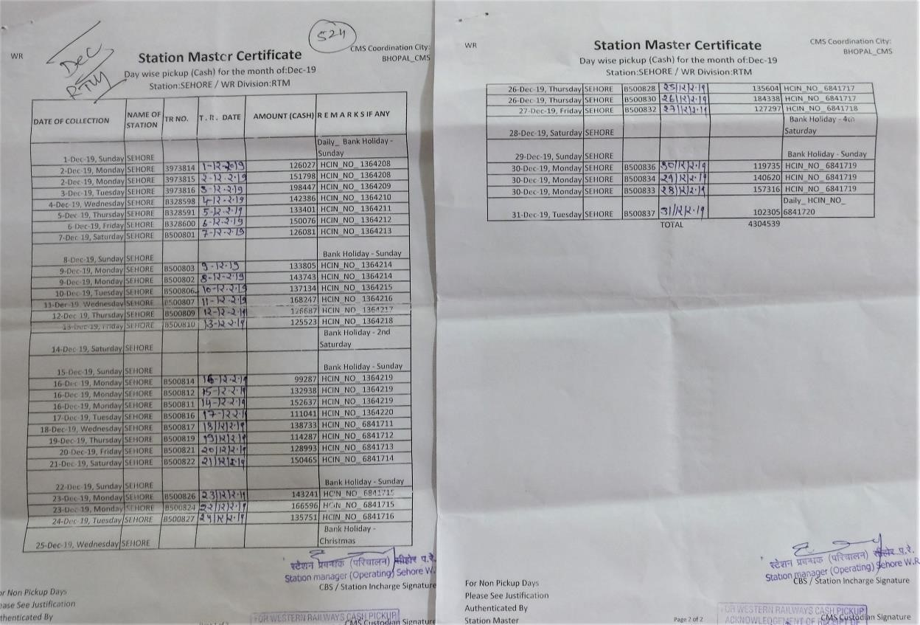

Slide 17
ACTIVITIES TO BE COVERED IN DRY RUN
CMS PERSON INTRODUCES SELF AS AGENT OF CMS.
EXPLAINS THE AUTHORISATION AND HCI PROCESS.
EXPLAINS PROCESS OF CASH HANDOVER / TAKEOVER.
CLARIFIES ON RESPONSIBLY OF CASH DISCREPANCY OR SHORTAGES IDENTIFY AT THE TIME OF CASH PICKUP AND POST CASH PICKUP.
HANDOVER BELOW ITEMS TO RAILWAY STATION AUTHORISED OFFICIAL:
SBI 1+3 DEPOSIT SLIP BOOKLET
CMS HCI 1+1 BOOKLET PART B HAVING 30 LEAFLETS
AUTHORISED PHOTO LIST
SAMPLE OF CMS EMPLOYEE IDENTIFY CARD
NEW REGISTER TO KEEP RECORDS OF DAILY VISIT
COPY OF PROCESS NOTE, DOS AND DON’T
FILLS THE DRY RUN FORM AND TAKES THE SIGNATURE OF RAILWAY STATION OFFICIAL.

Slide 18
QUESTIONS?

